Slide 1
What's New in Educational Technology: A Report from Educause
Julie Zhu, Ph.D.
Center for Teaching and Learning
Notes:
This template is in wide-screen format and demonstrates how transitions, animations, and multimedia choreography can be used to enrich a presentation.

Slide 2



The Educause Conference
Over 7000 higher education IT professionals and technology providers
295 exhibitors

Slide 3
New and emerging Educational technologies
Turning Technologies Student Response System
Smart Campus by Ink
ZOOM Video Conferencing System
Laptop Automatic Checkout Kiosks
OfficeMix
Epson Interactive Projector
Google Apps including Classroom
WACOM Pen Computers
Panopto Lecture Capture System
Skykit Digital Signage for Education

Slide 4
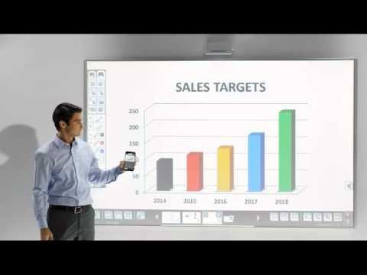
Epson Interactive Projectors
Can turn any flat surface into an interactive whiteboard on which you can annotate
Digital whiteboard can be shared with remote participants
Notes:
Interactive projectors are a new technology that can turn any flat surface into an interactive whiteboard on which you can annotate. Epson BrightLink Pro 1430Wi integrates the utility of your whiteboard, projector and interactive display and easily connects to video conferencing equipment. It turns any surface into an interactive area on which you can annotate. Remote participants can use their mobile devices and write to the digital whiteboard in real time. Share notes easily; save, email or print directly - no PC or software required. Just turn it on and start writing with the pens or your fingers. A video presentation of this projector can be accessed at: https://www.youtube.com/watch?v=FZyhjU2mLgI. Additional information about this projector can be accessed on Epson's site.

Slide 5
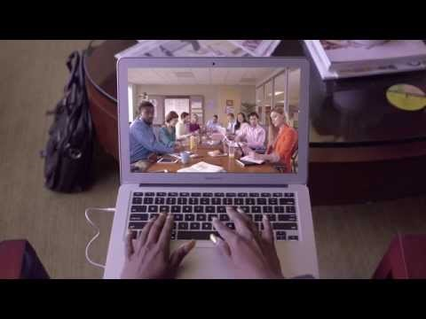
Zoom Video Conferencing System
Cloud-based
Collaborate with anyone, anywhere
High quality audio, video, screens-sharing across different computer platforms and mobile devices.
Notes:
Cloud Video Conferencing
HD video
HD Voice with dynamic voice detection
Full screen and gallery view
Dual stream for dual screen
Feature-rich mobile apps for iOS and Android
Join by Zoom Rooms
Join as view-only attendee (Zoom Video Webinar)
Join by H.323/SIP room systems
Join by telephone dial-in
Accessibility

Slide 6
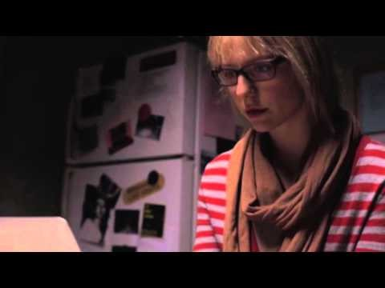
Panopto Lecture Capture System
A relatively new lecture capture system
Offers a flexible video and audio recording system
Powerful search engine
Recordings can be converted to MP4 format
Sample Panopto Recording
Notes:
Key features of Panopto (Please see attached brochure for additional information):
Lecture Capture - Panopto is a lecture capture system built with the flexibility to record any combination of video sources, in any configuration, in classrooms of any size. And Panopto scales with ease to meet your institution’s needs — from small departmental deployments to campus-wide installations.
Flipped Classroom - Panopto provides an easier way to record short, engaging flipped classroom videos. Using your Windows PC or Mac, you can record slides and other on-screen content along with audio or video of you presenting. These microlectures help students learn the key points they’ll need before class begins.
Flexibility - Panopto includes a flexible video recording system that enables you to capture flipped classroom materials using a range of video sources and mobile devices. Using your iPad, iPhone, or Android device, you can easily upload videos that you’ve captured around campus, at home, in the lab, or in the field. And if you’re recording from your laptop or desktop computer, you can record video using webcams, HD camcorders, document cameras, and more.
Media Import features:
Drag-and drop import provides an easy-to-use interface for ingesting media into the Panopto video CMS.
Broad format support enables you to upload WMV, AVI, MPG, MP4, MOV, 3GPP, WMA, MPEG, PS, TS, QT, MP2, M2a, M2V, M4a, M4V, GoToMeeting, and Camtasia files.
Video transcoding acts as a universal translator for existing media, converting disparate formats into HTML5- compatible video that can be played back in Panopto’s interactive video player, an HTML5-compatible MP4 video podcast, and an MP3 audio podcast.
Slide sync enables you to combine video recordings and their related PowerPoint slides into a single video.
Batch upload enables users to drag and drop hundreds of media files into Panopto for simultaneous ingestion.
Recording Features:
Distributed recording enables different parts of a presentation or event to be captured from different machines, and then automatically combined into a single viewing experience (Unique feature).
Multi-monitor support enables you to screencast multiple monitors attached to a single PC (Unique feature).
Multi-camera video enables presenters to capture multiple video devices (web cams, DV cameras, desktop capture, smart whiteboards, document cameras and more) simultaneously from a single PC (Unique feature).
Failsafe recording and webcasting protects Panopto recordings from data loss in the face of power outages, hardware failure, and operating system crashes.
60fps streaming support provides industry-leading, broadcast-quality video delivery to desktops, laptops, and mobile devices
Webcasting Features:
One-click webcasting enables you to live stream a presentation, event, or meeting simply by checking a checkbox.
Live Q&A enables webcast viewers to submit questions to the presenter during the live streamed event.
Multi-stream webcast enables you to stream multiple video streams in HD from a single PC. (Unique feature)
Distributed webcast enables different parts of a presentation or event to be broadcast from different machines, and then automatically combined into a single live viewing experience. (Unique feature)
Panopto URLs provide a single link for viewing a video – live and on-demand.
Video Management and Search
Smart Search is an industry-leading video search engine that enables users to search across their entire video library and inside individual videos for any word spoken or shown. Automatic Speech Recognition (ASR) indexes spoken words in video and audio recordings, enabling Smart Search to find words in the media talk track. Optical Character Recognition (OCR) indexes on-screen words in videos, enabling Smart Search to find typewritten content within videos.
HLS media pipeline provides businesses and universities with the first standards-based video platform for recording, live broadcasting and watching videos from any device. The pipeline streams all video over ports 80 and 443, eliminating the need for system administrators to reconfigure their proxies and firewalls for video delivery.
Approval workflows enable video creators, videographers, and administrators to set up rules for moderating and reviewing content before it becomes available for playback.
Availability windows enable video creators, videographers, and administrators to set start and end availability for folders and individual videos.

Slide 7
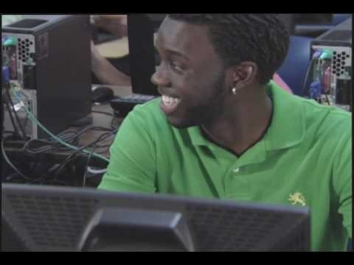
Turning Technologies Student Response System
ResponseWare – a mobile response solution to be used with any web-enabled device. Participants view and respond to interactive questions with smart phones, tablets or computers.
ResponseWare requires a subscription.
Notes:
Utilize existing devices with ResponseWare. Our mobile solution can be used with any web-enabled device and allows participants to view and respond to interactive questions. Whether using a smart phone, tablet or computer, ResponseWare offers the same experience for all users.

Slide 8
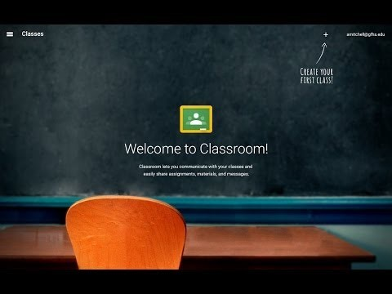
Google classroom
A blended learning platform for schools that aims to simplify creating, distributing and grading assignments in a paperless way.
A feature of Google Apps for Education.
Notes:
I like the following features:
Clean and easy to use Interface
Integration with Google Drive and Google Calendar
Utilize Google Sheet for grading
Things that I see lacking:
Some communications tools such as blogs, journals, etc.
I don't see an export/import feature
No student view so I'm not sure what it looks like to students
Features are pretty generic.
No course menu so it's hard to categorize content posted.

Slide 9
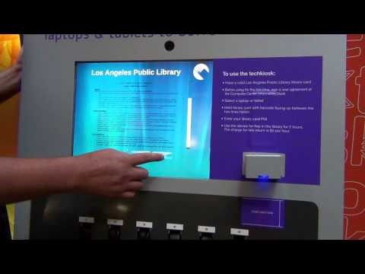
Laptop Automatic Checkout Kiosks
Transforms campus facility
Automatically checks out laptops and tablets.

Slide 10

Skykit Digital Signage for Education

Slide 11
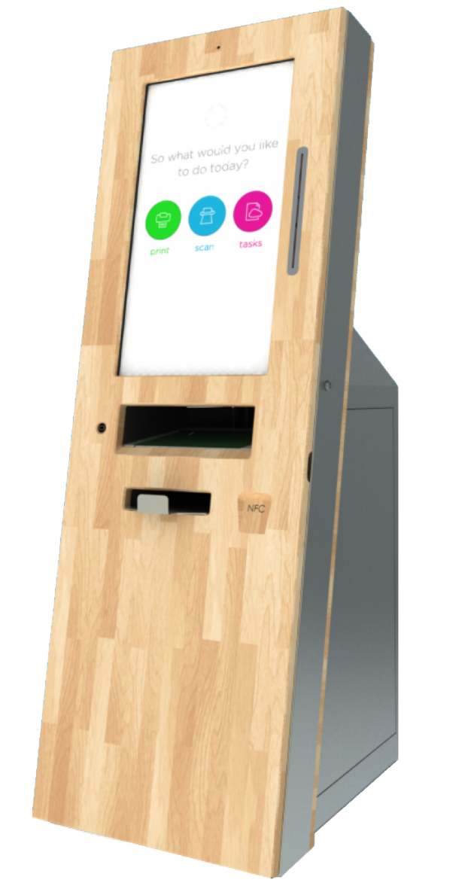
Smart Campus by Ink
Ink Smart Station
Print from anything, anywhere, anytime
Notes:
Utilize existing devices with ResponseWare. Our mobile solution can be used with any web-enabled device and allows participants to view and respond to interactive questions. Whether using a smart phone, tablet or computer, ResponseWare offers the same experience for all users.

Slide 12
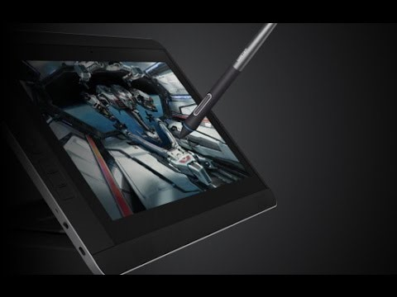
WACOM Pen Computers
Cintiq Companion 2
Combines the on-screen experience of a Cintiq pen display with the mobility of a Windows 8 or 7 tablet.
Great for drawing, illustration, graphic design and image editing
Notes:
Utilize existing devices with ResponseWare. Our mobile solution can be used with any web-enabled device and allows participants to view and respond to interactive questions. Whether using a smart phone, tablet or computer, ResponseWare offers the same experience for all users.

Slide 13
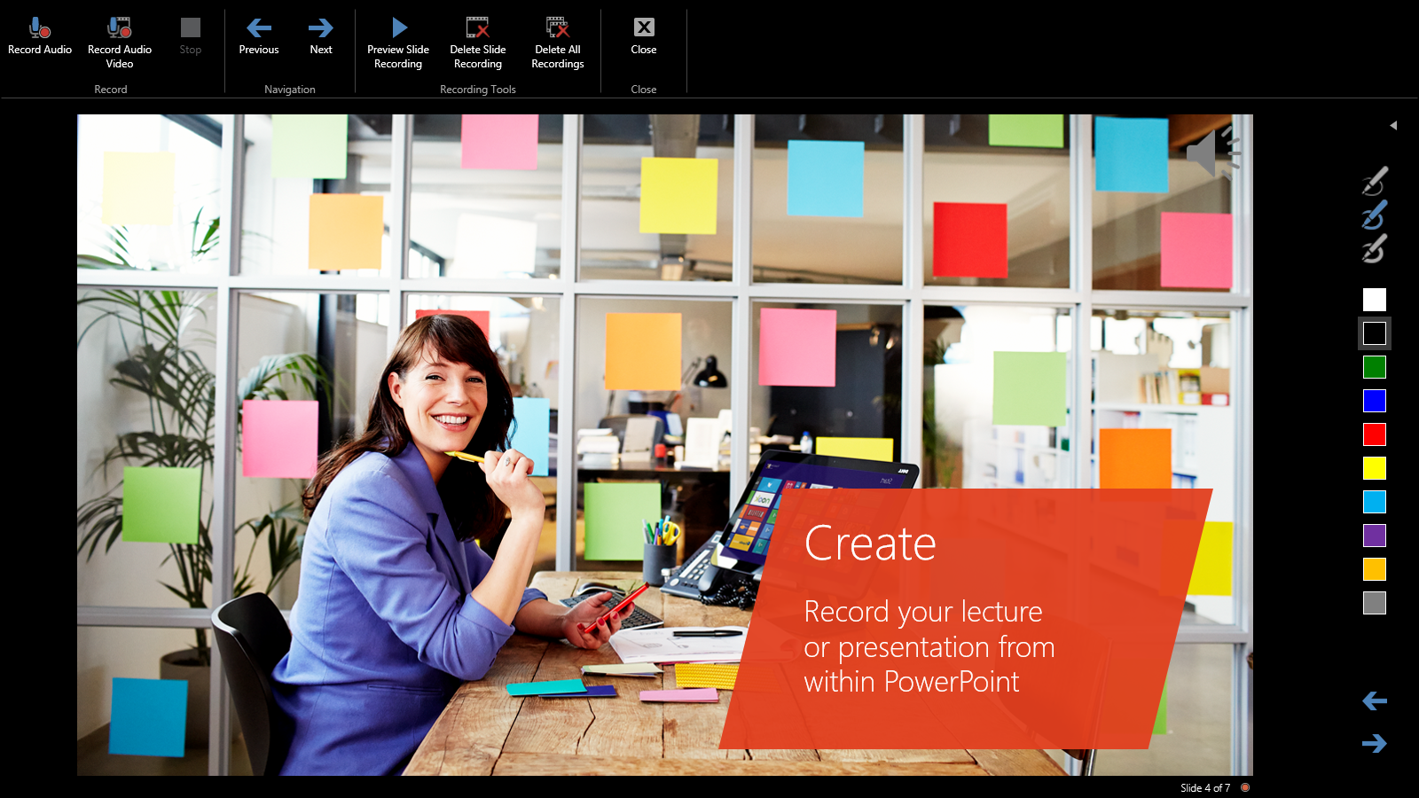
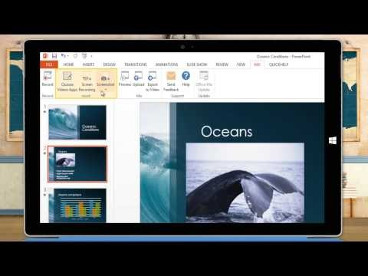
OFFICEMIX
A free add-in for PowerPoint
Easily create and share interactive online videos
Polls & Interactive Apps
Notes:
Utilize existing devices with ResponseWare. Our mobile solution can be used with any web-enabled device and allows participants to view and respond to interactive questions. Whether using a smart phone, tablet or computer, ResponseWare offers the same experience for all users.

